Slide 1
FITness Buddy
IBM AICTE PROJECT
Presented By:
Student name : Lucky Sharma
College Name : MIT Academy of Engineering , Alandi
Department : Computer Engineering

Slide 2
OUTLINE
Problem Statement
Technology used
Wow factor
End users
Result
Conclusion
Git-hub Link
Future scope
IBM Certifications

Slide 3
Problem Statement
In today’s fast-paced world, many individuals struggle to maintain a healthy lifestyle due to lack of personalized guidance, time constraints, and inconsistent motivation. Traditional fitness solutions often require expensive subscriptions, in-person consultations, or rigid schedules that don't adapt to personal preferences or daily routines.
Proposed Solution: FitBuddy is a conversational AI agent designed to promote healthier lifestyles by offering personalized home workouts, simple nutrition advice, daily motivation, and habit-building tips. Accessible anytime, it eliminates the need for subscriptions or rigid schedules, making fitness support flexible, affordable, and user-friendly.

Slide 4
Technology used
IBM cloud lite services
Natural Language Processing (NLP)
IBM Granite model
Watsonx Studios and AI

Slide 5
IBM cloud services used
IBM Cloud Watsonx AI Studio
IBM Cloud Watsonx AI runtime
IBM Cloud Agent Lab
IBM Granite foundation model
IBM Cloud Object Storage

Slide 6
Wow factors
Delivers personalized fitness and meal suggestions tailored to user needs
Engages in natural, conversational interactions without commands
Accessible 24/7 for instant guidance anytime, anywhere
Citation and reference analysis to trace influence
Encourages consistent habits with motivational support
Smart Nutrition Advice – Simple, healthy meal ideas for everyday needs
AI-Powered Intelligence – Adapts responses using advanced language models

Slide 7
End users
Working individuals
Students aiming to maintain health on a tight schedule
Beginners starting their fitness journey
Frequent travelers needing portable wellness support
Home-makers seeking simple fitness and meal guidance

Slide 8
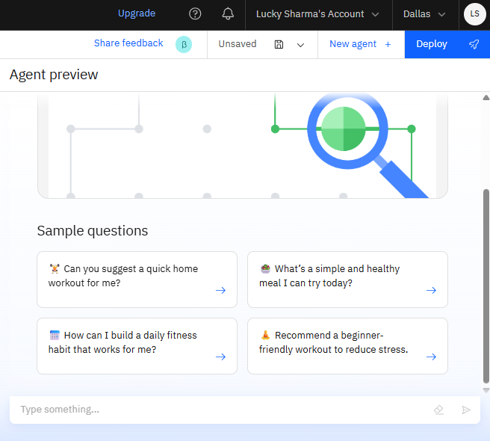
Results

Slide 9
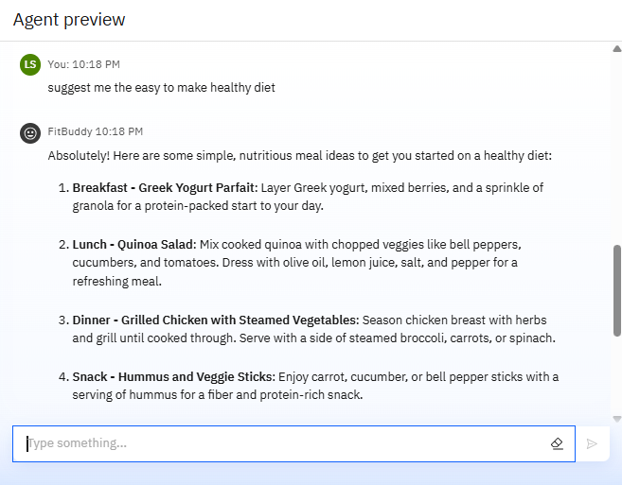
Results

Slide 10
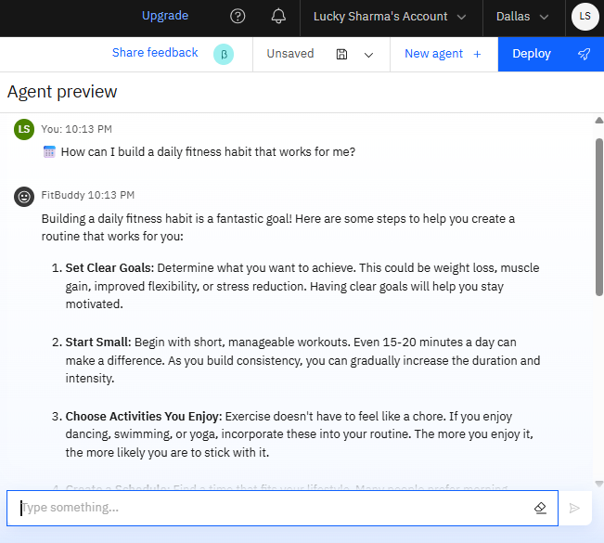
Results

Slide 11
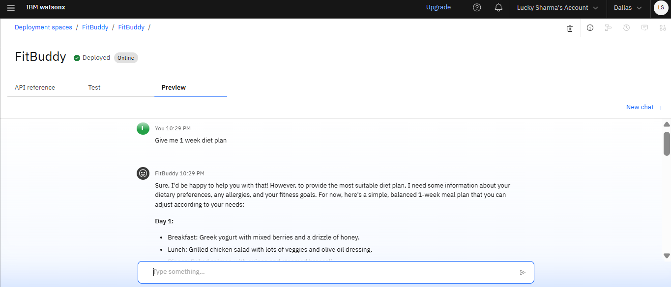
Results
Deployed AI Agent

Slide 12
Conclusion
FitBuddy addresses real-world fitness challenges by offering personalized, on-demand support.
It makes healthy living accessible through simple workouts, practical nutrition advice, and motivational guidance.
Unlike traditional fitness apps, it fits seamlessly into a user’s daily routine without requiring rigid schedules or subscriptions.

Slide 13
GitHub Link
Github link : https://github.com/lucky-sharma02/FitBuddy_IBM_Cloud_Project

Slide 14
Future scope
Voice command support
Medical-based workout plans
Smart AI progress tracking
Mental wellness features
Wearable device integration
Diet and calorie tracking

Slide 15
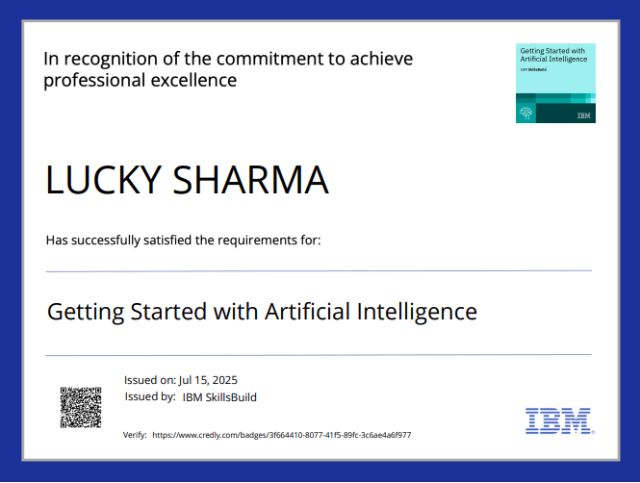
IBM Certifications

Slide 16
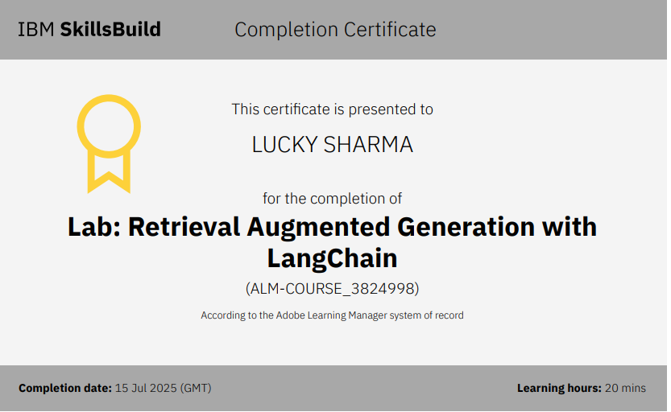
IBM Certifications

Slide 17

IBM Certifications

Slide 18
THANK YOU

